Slide 1
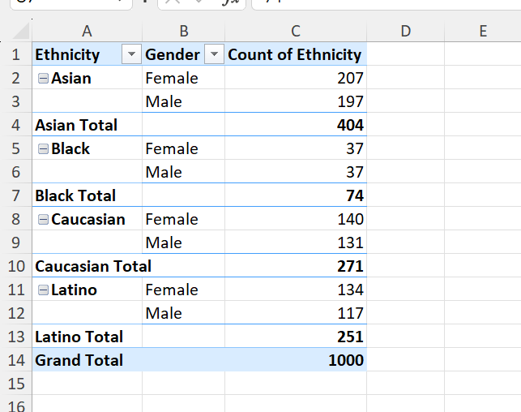
TASK 1:
From the table we can conclude that there are 207 Asian females and Asian 197 males are there in the company, and 37 black females and 37 black males are there,and there are 140 Caucasian females and 131 Caucasian males are there and 134 latino males and 117 females are there

Slide 2
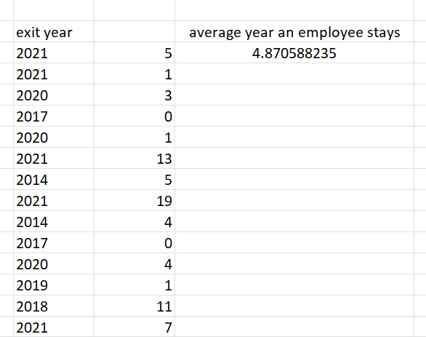
Task 2:
From this we can conclude that an average year an employee works before leaving the company is 4.8years

Slide 3
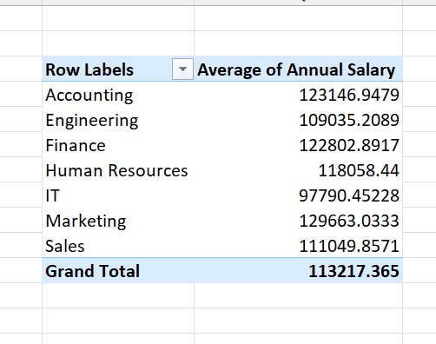
Task 3:
From this we can conclude the difference in the average salary between different departments

Slide 4
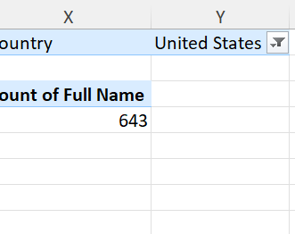
Task 4:
From this we can conclude that united states has the most number of employees

Slide 5
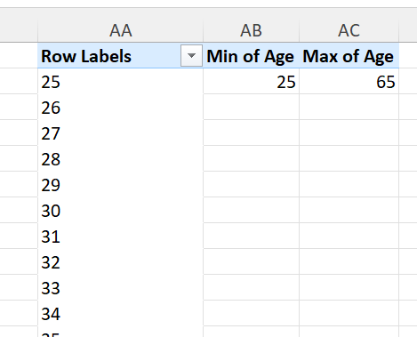
Task 5:
From this we can conclude that athe avg age difference is 1 years whereas the emplyess has a min age of 25 and max age of 65

Slide 6
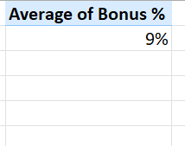
Task 6:
The avg bonus given for the employees is 9%

Slide 7
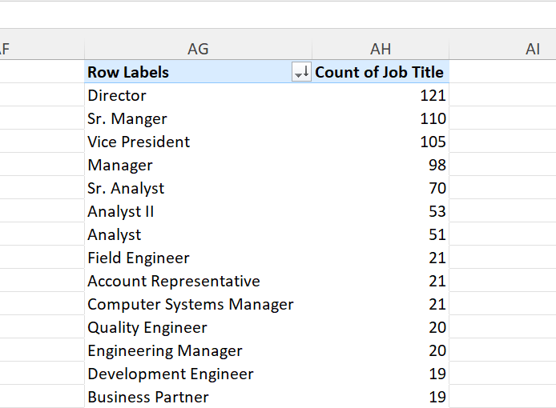
Task 7:
Form this we can conclude that director job occurs more frequently

Slide 8
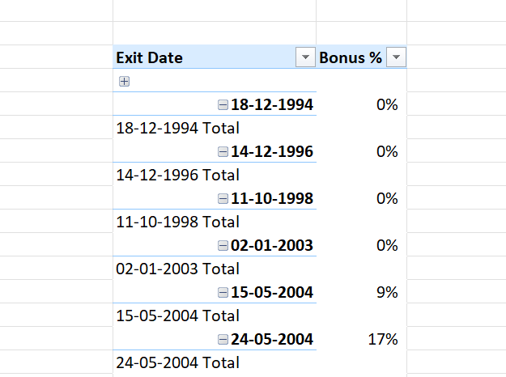
Task 8:
The primary reason is that they are not getting enough bonus

Slide 9
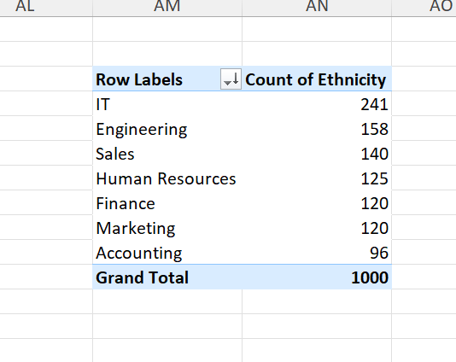
Task 9:
From this we can conclude that IT department has more diverse in ethinicity

Slide 10
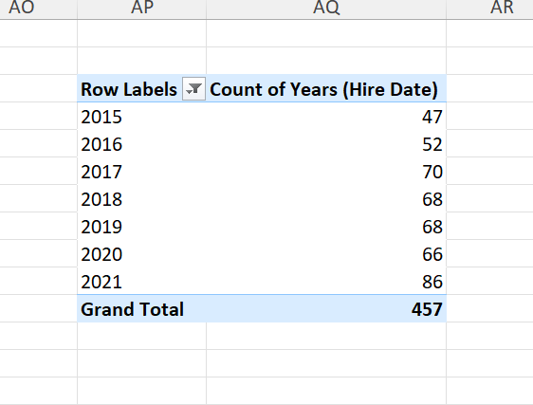
Task 10:
From this we can conclude that there has been an increase in hires over recent years

